Slide 1
Design and Analysis of Algorithms (UE20CS251)
Unit III - Transform-and-Conquer
Mr. Channa Bankapur
channabankapur@pes.edu

Slide 2
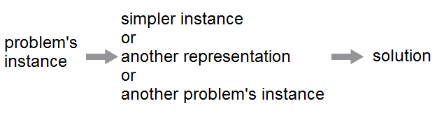
Transform-and-Conquer:

Slide 3
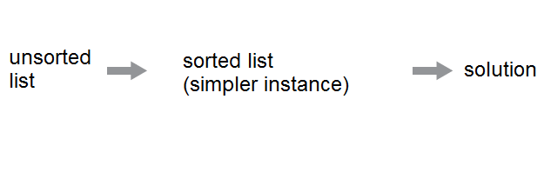
Presorting:
Interest in sorting algorithms is due, to a significant degree, to the fact that many questions about a list are easier to answer if the list is sorted.

Slide 4
Finding the largest element in an array of n numbers using the following approaches:
Brute Force
Decrease-n-Conquer
Divide-n-Conquer
Transform-n-Conquer (Presorting-based)

Slide 5
Write an algorithm for:
Checking element uniqueness in an array
using presorting-based technique.
Analyze its time efficiency.
Compare with the brute force algorithm.

Slide 6
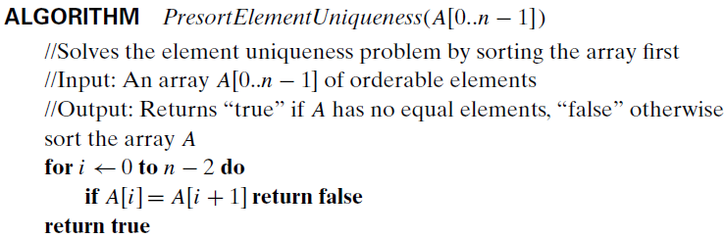

Slide 7
Write an algorithm for:
Computing a mode in an array
using presorting-based technique.
Analyze its time efficiency.
Compare with the brute force algorithm.

Slide 8
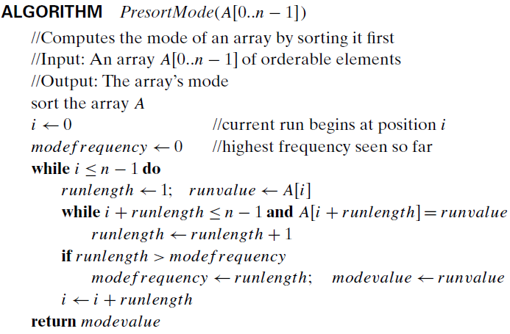

Slide 9
Write an algorithm for:
Computing a mode in an array
using presorting-based technique.
Analyze its time efficiency.
Compare with the brute force algorithm.

Slide 10
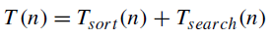
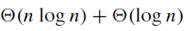
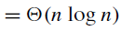
Write an algorithm for:
Searching an element in an array
using presorting-based technique.
Analyze its time efficiency.
Compare with the brute force algorithm.

Slide 11
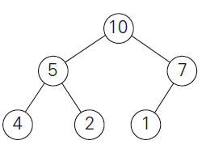
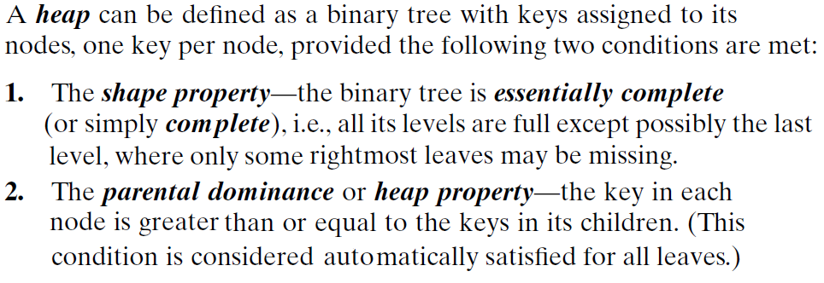
Heaps:

Slide 12
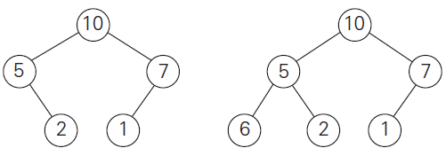
Heaps:
Which of the following are heaps?

Slide 13
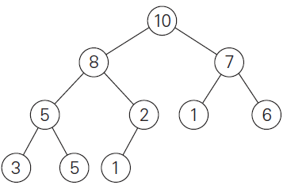
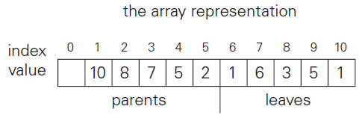

Slide 14
A heap can be implemented as an array by recording its elements in the top-down, left-to-right fashion (BFS-way).
In such a representation (for convenience let’s store the heap’s elements in positions 1 through n of the array),
the parental node keys will be in the first ⌊n/2⌋ positions of the array, while the leaf keys will occupy the last ⌈n/2⌉ positions.
the children of a key in the array’s parental position i (1 ≤ i ≤ ⌊n/2⌋) will be in positions 2i and 2i+1, and, correspondingly, the parent of a key in position j (2 ≤ j ≤ n) will be in position ⌊j/2⌋.

Slide 15
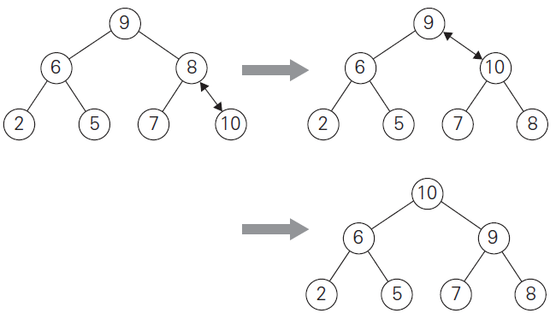
Inserting a new element in the heap:
Add new element ‘10’ to the existing heap.

Slide 16
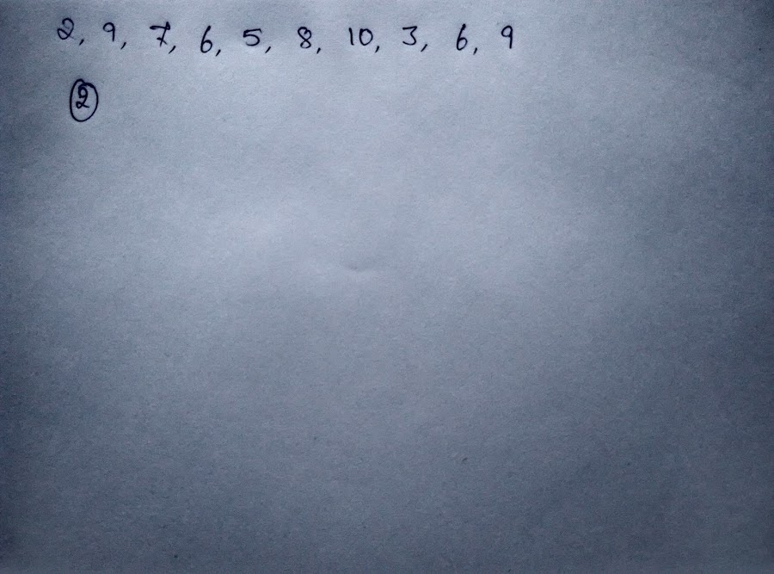
Construction of a heap from top-down:

Slide 17
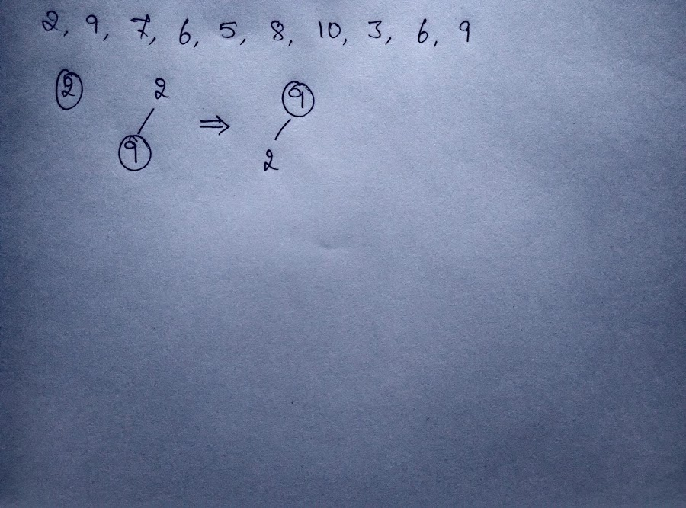
Construction of a heap from top-down:

Slide 18
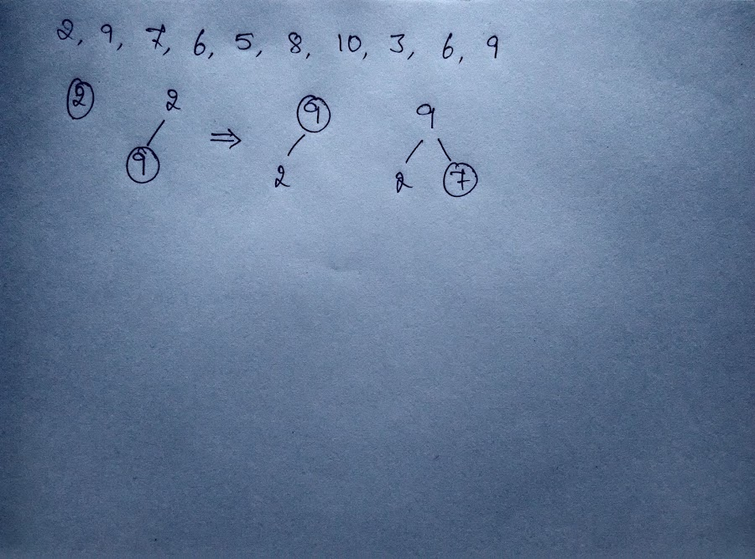
Construction of a heap from top-down:

Slide 19
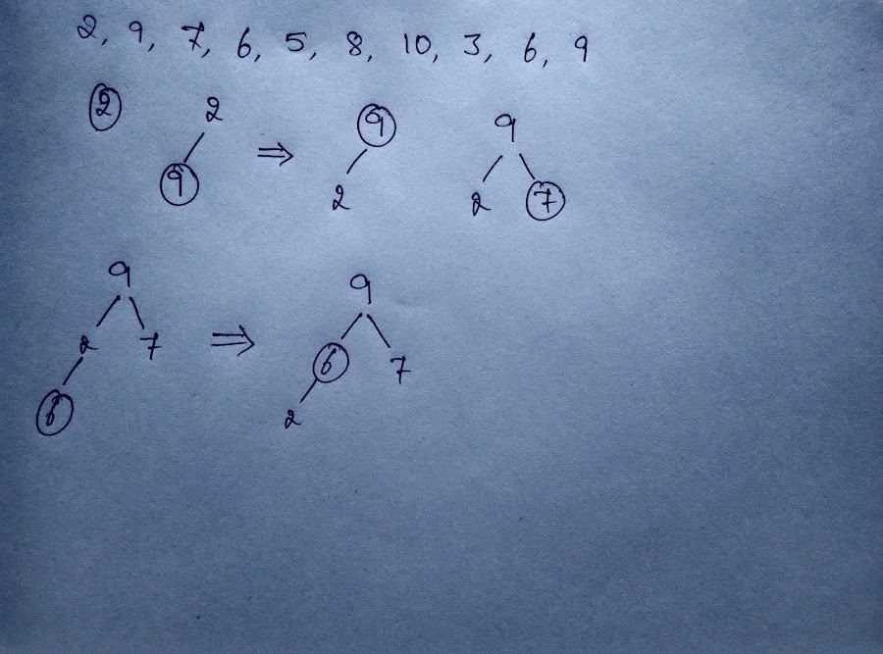
Construction of a heap from top-down:

Slide 20
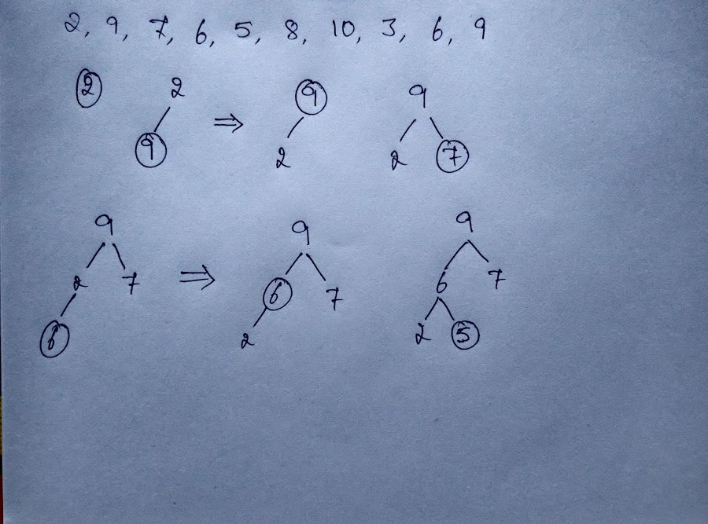
Construction of a heap from top-down:

Slide 21
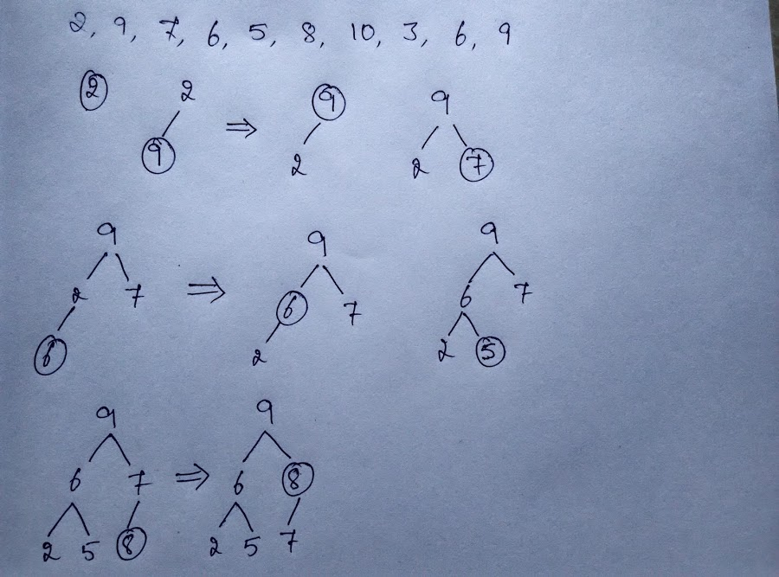
Construction of a heap from top-down:

Slide 22
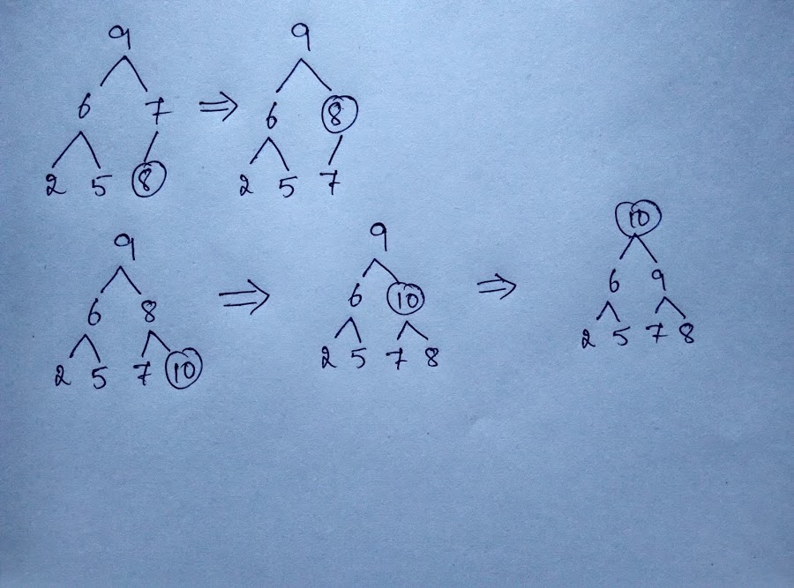
Construction of a heap from top-down:

Slide 23
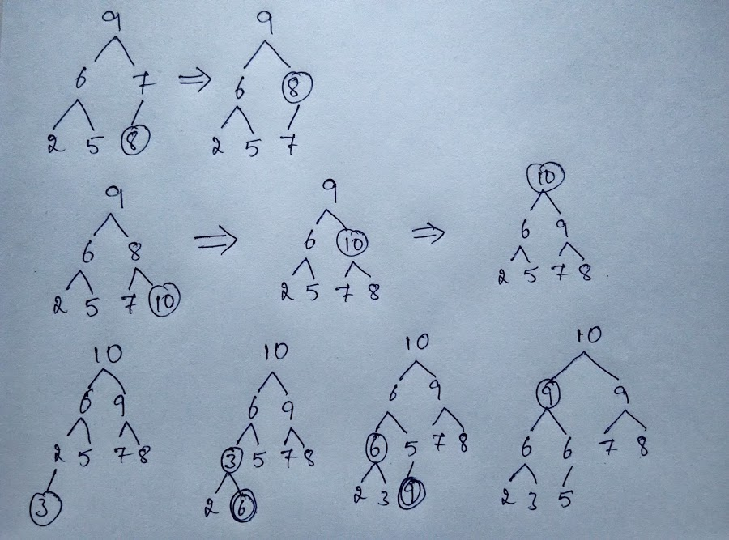
Construction of a heap from top-down:

Slide 24
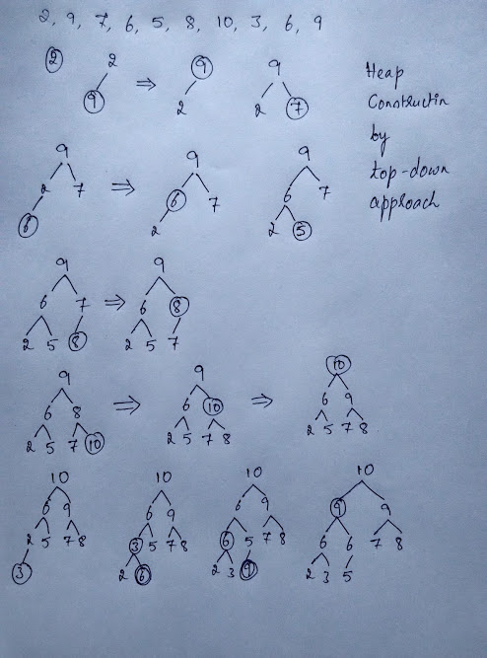

Slide 25
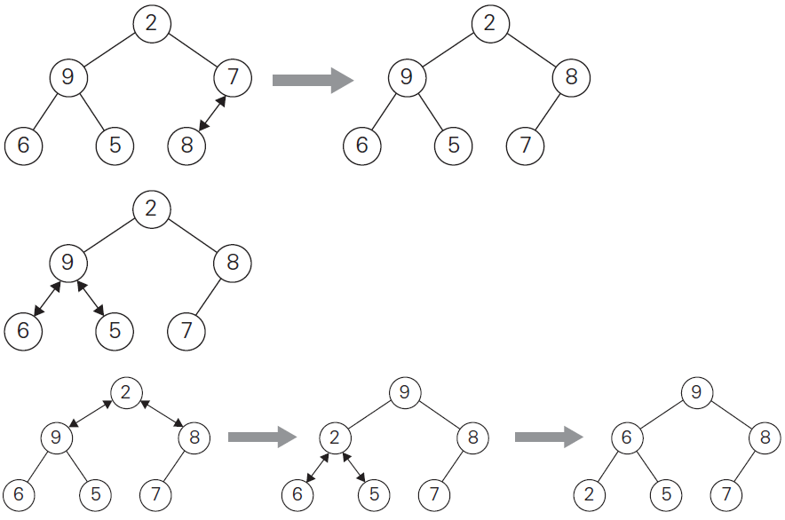

Slide 26
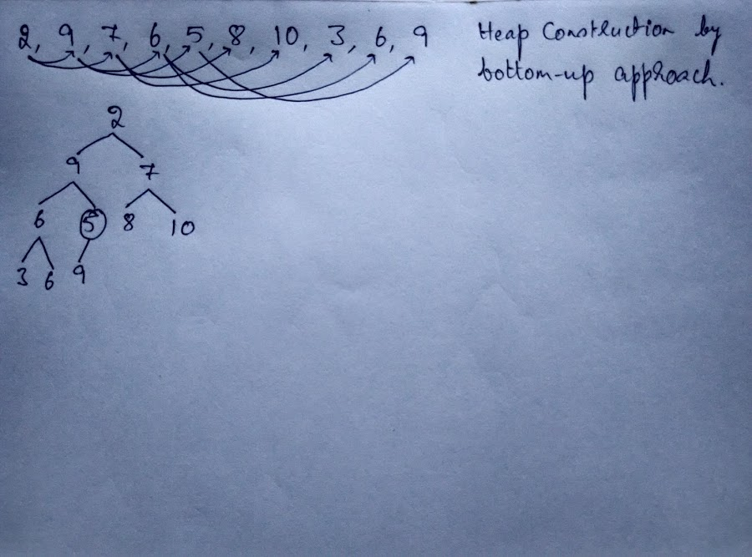

Slide 27
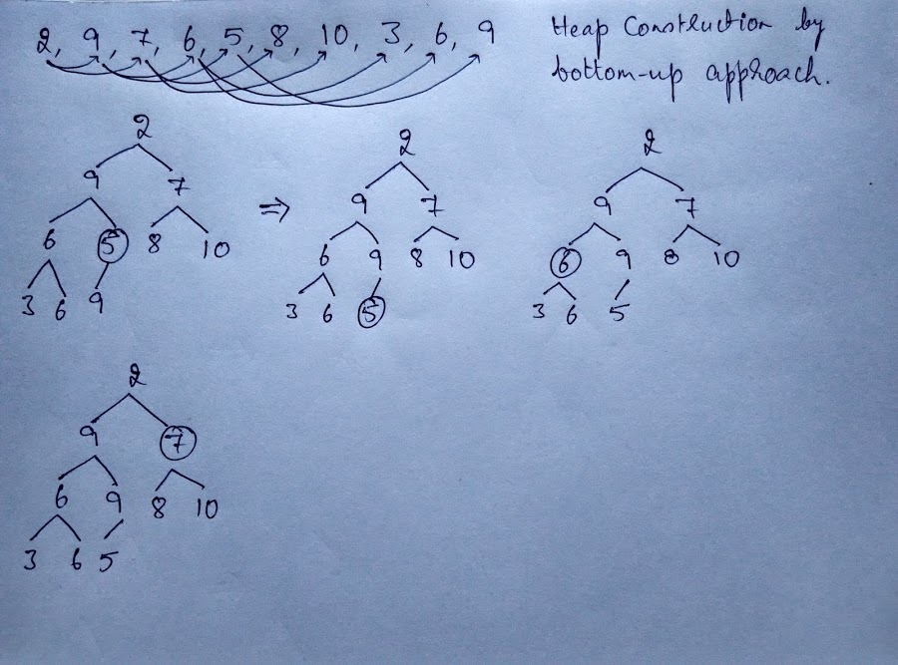

Slide 28
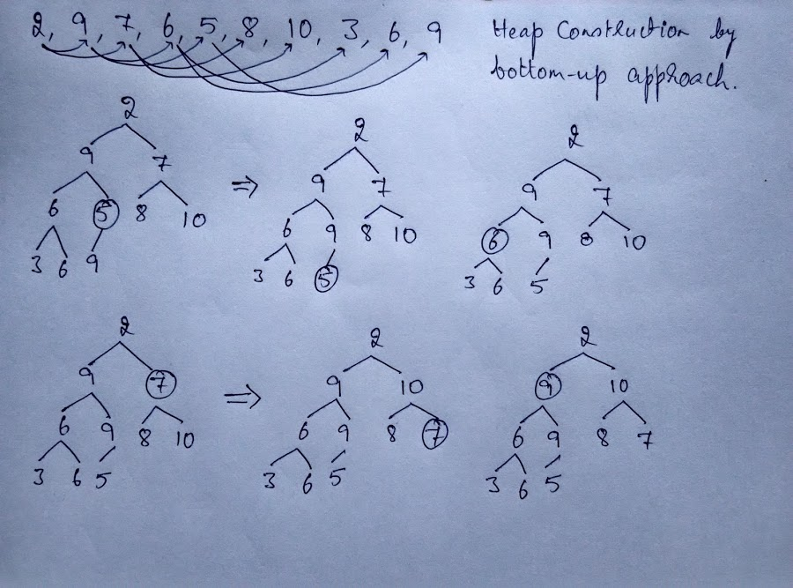

Slide 29
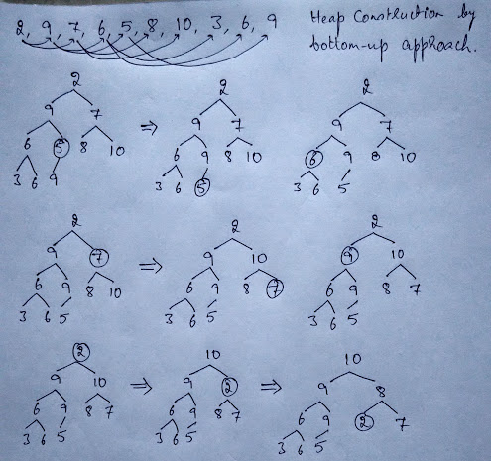

Slide 30
HeapBottomUp(H[1..n])
if(n ≤ 1) return
for i ← ⌊n/2⌋ downto 1 do
Heapify(H, i)
//For the subtree rooted at k, it sifts down H[k]
//as much as possible until it becomes a heap.
Heapify(H[1..n], k)
if(2*k > n) return //if H[k] is a leaf
j ← 2*k //j points to left child of H[k]
if(j+1 ≤ n) //if there exists a right child of H[k]
if(H[j+1] > H[j]) j ← j+1
if(H[j] > H[k]) //if greater child is greater than H[k]
H[j] ↔ H[k]
Heapify(H, j) //Heapify the subtree rooted at j

Slide 31
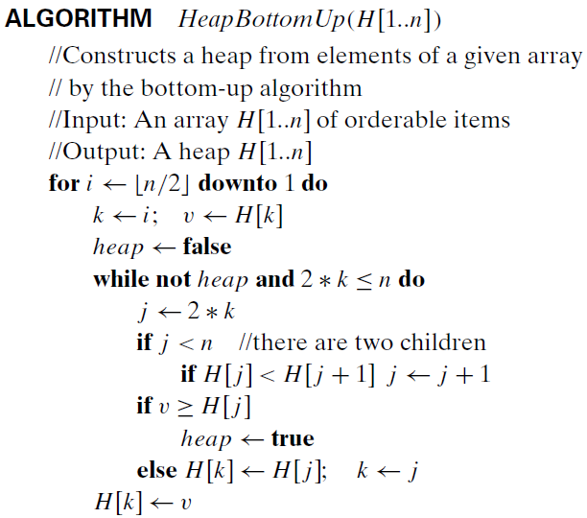

Slide 32
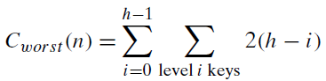
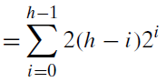
Efficiency of construction of heap from bottom-up:
Let h be the height of the tree.
Two key comparisons at level of trickle down of an element.
≅ 2n ∈ Θ(n)

Slide 33
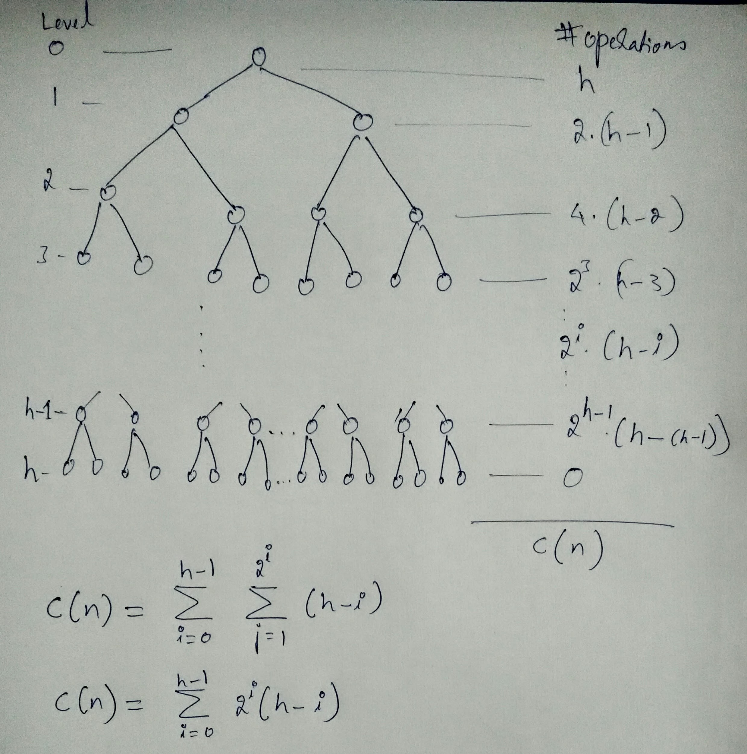

Slide 34
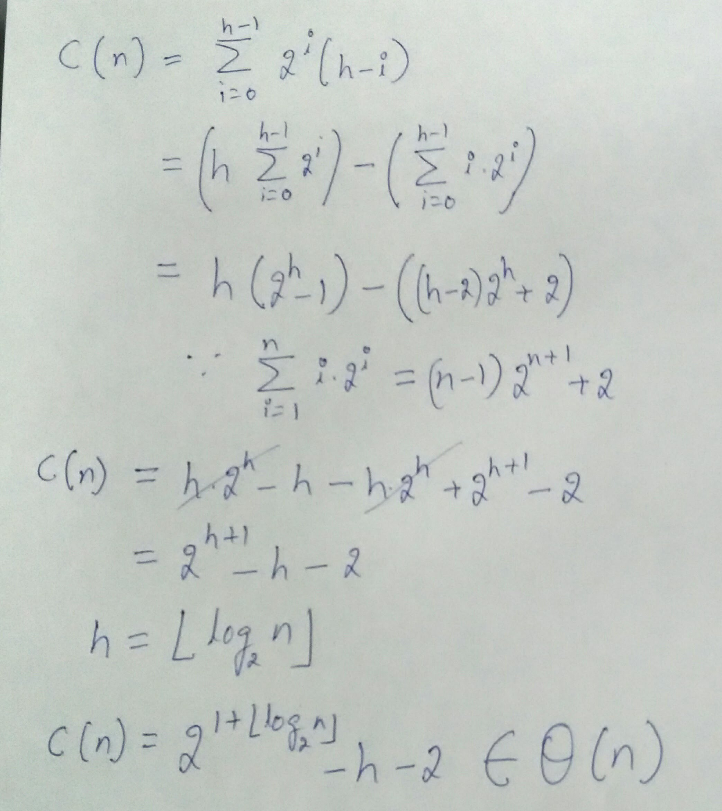

Slide 35
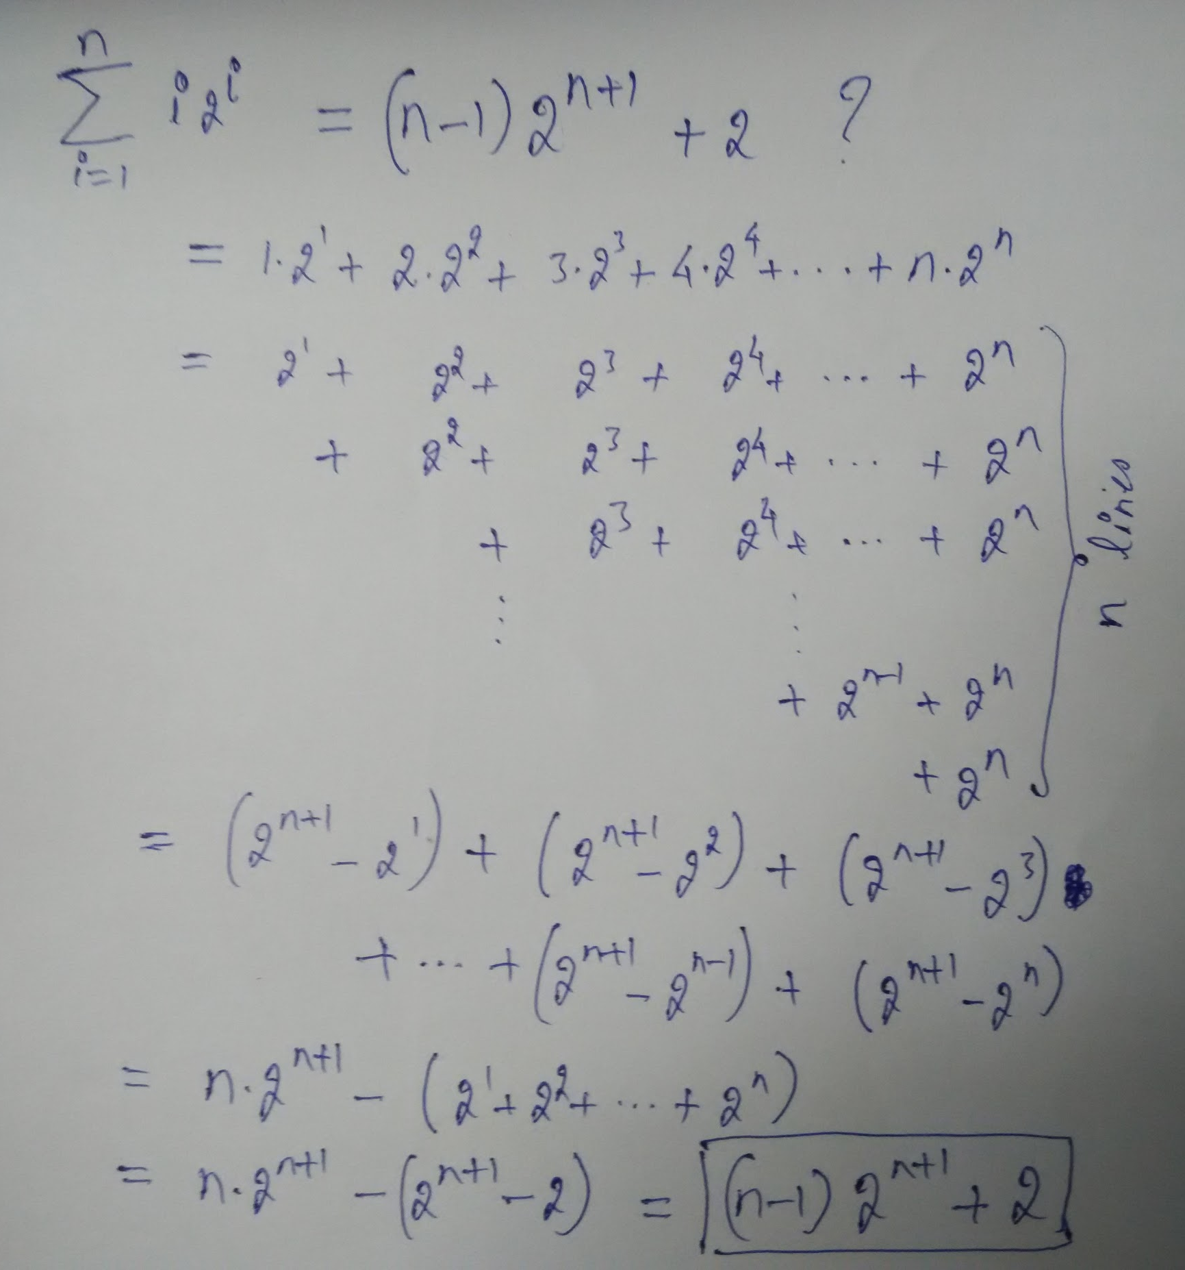

Slide 36
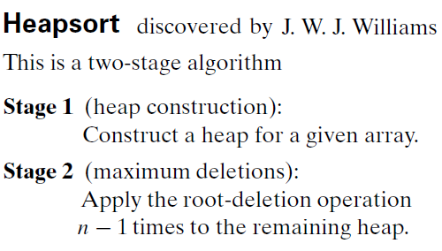

Slide 37
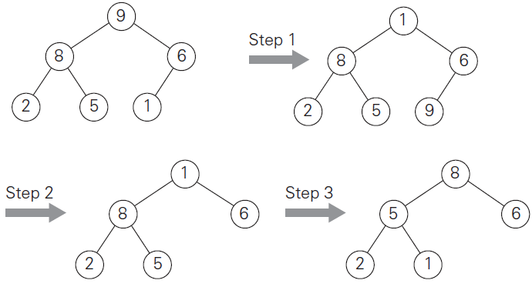
Maximum
Key Deletion
from a heap
Exchange the
root’s key with
the last key K
of the heap.
Decrease the heap’s size by 1.
“Heapify” the smaller tree by sifting K down the tree exactly in the same way we did it in the bottom-up heap construction algorithm.

Slide 38
HeapSort(H[1..n])
HeapBottomUp(H[1..n]) //Construct heap
for i ← n downto 2 do
H[1] ↔ H[i] //H[1] has the max element.
Heapify(H[1..i-1], 1) //Sift down H[1]
HeapBottomUp(H[1..n])
if(n ≤ 1) return
for i ← ⌊n/2⌋ downto 1 do
Heapify(H, i)
Heapify(H[1..n], k)
if(2*k > n) return //if H[k] is a leaf
j ← 2*k //j points to left child of H[k]
if(j+1 ≤ n) //if there exists a right child of H[k]
if(H[j+1] > H[j]) j ← j+1
if(H[j] > H[k]) //if greater child is greater than H[k]
H[j] ↔ H[k]
Heapify(H, j) //Heapify the subtree rooted at j

Slide 39
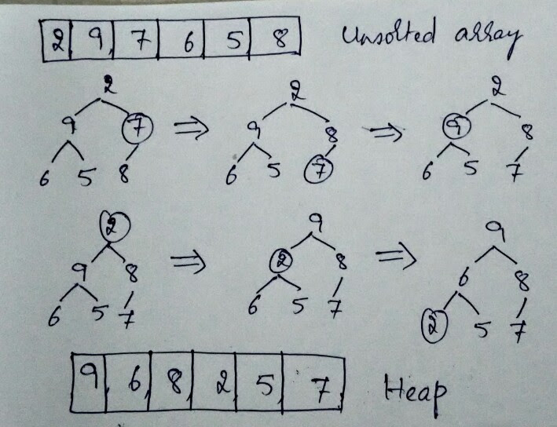

Slide 40
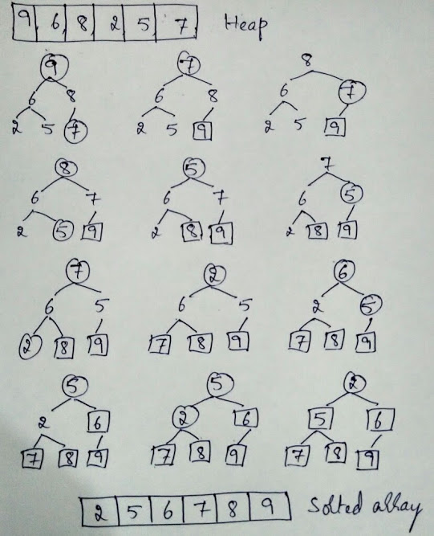

Slide 41
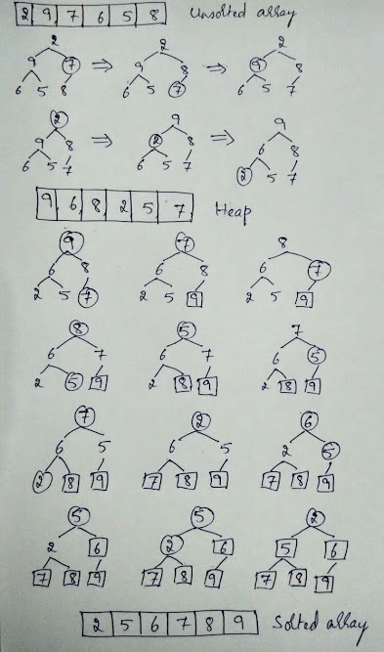
Analysis of Heapsort:
T_{Heapsort}(n) = T_{Heap}(n) + T_{Sort}(n)
T_{Heapsort}(n) ∈ max{𝚹(n), 𝚹(n logn)}
T_{Heapsort}(n) ∈ 𝚹(n logn)

Slide 42
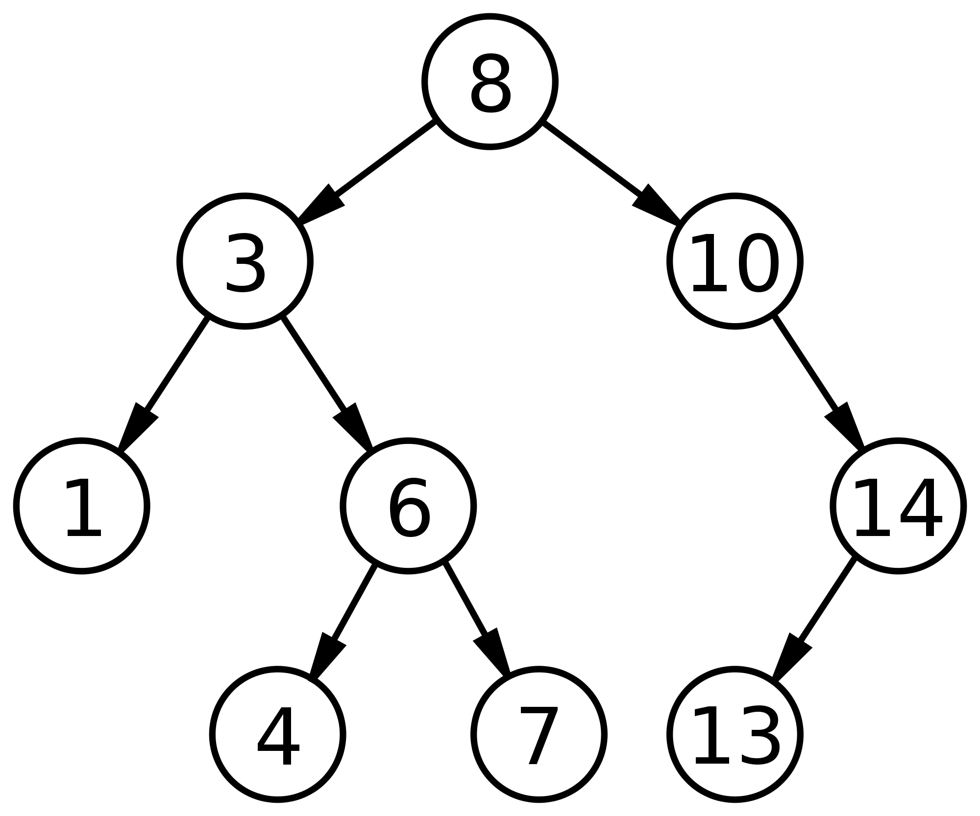
Binary Trees
Binary Search Trees (BST)
What do we “conquer” by
transforming a
Binary Tree into a BST?
[Optional]
Boolean isBST(BinaryTree t);
BST BT2BST(BinaryTree t);

Slide 43
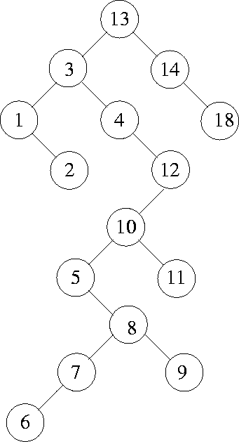
Binary Trees
Binary Search Trees (BST)
What do we “conquer” by transforming a Binary Tree into a BST?
Search!
Time complexity of
Inserting an element into a BST:
Searching for an element in a BST:
Average case:
Worst case:

Slide 44
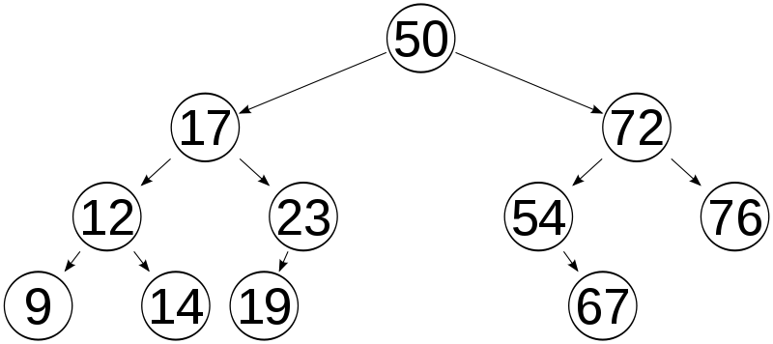
Balanced Binary Search Trees:
Time complexity of worst-case of search in a BST is O(n)
How can we keep the BST balanced so that the worst-case is just O(log n) because the height of the tree is limited to O(log n)?

Slide 45
Balanced Binary Search Trees:
Time complexity of worst-case of search in a BST is O(n)
How can we keep the BST balanced so that the worst-case is just O(log n) because the height of the tree is limited to O(log n)?
AVL Trees
Red-Black Trees
Splay Trees (Randomized)
Search Trees that are Balanced Search Trees, but not binary trees.
2-3 Trees, 2-3-4 Trees
B Trees, B+ Trees

Slide 46
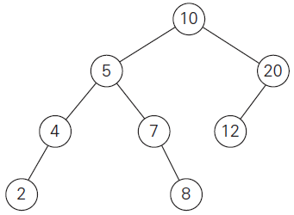
AVL Trees: An AVL tree is a BST in which the balance factor of every node is either 0, +1 or -1.
Balance factor: The difference between the heights of the node’s left and right subtrees.
Height of a tree: The longest
path from the root to a leaf.
The height of a null tree
is defined as -1.

Slide 47
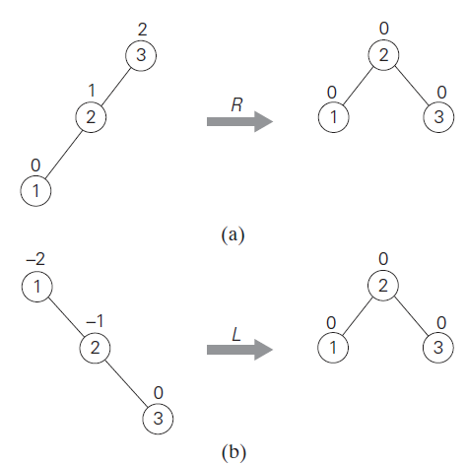
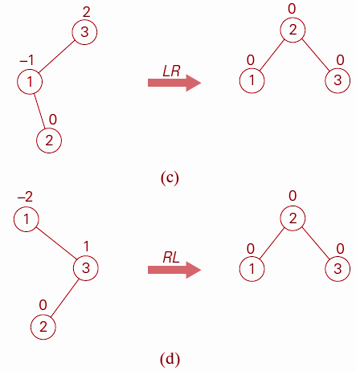

Slide 48
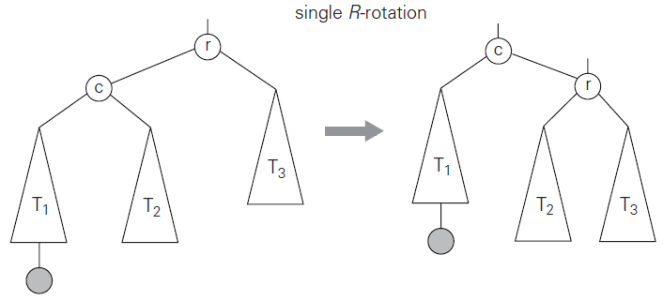
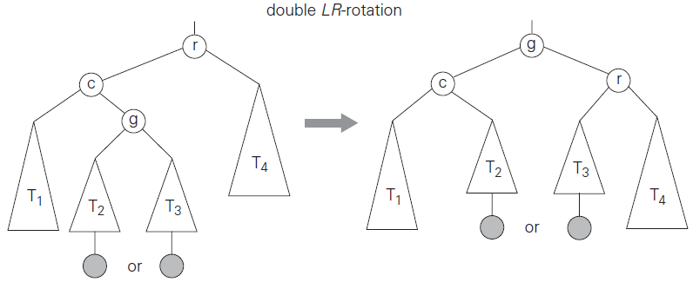

Slide 49
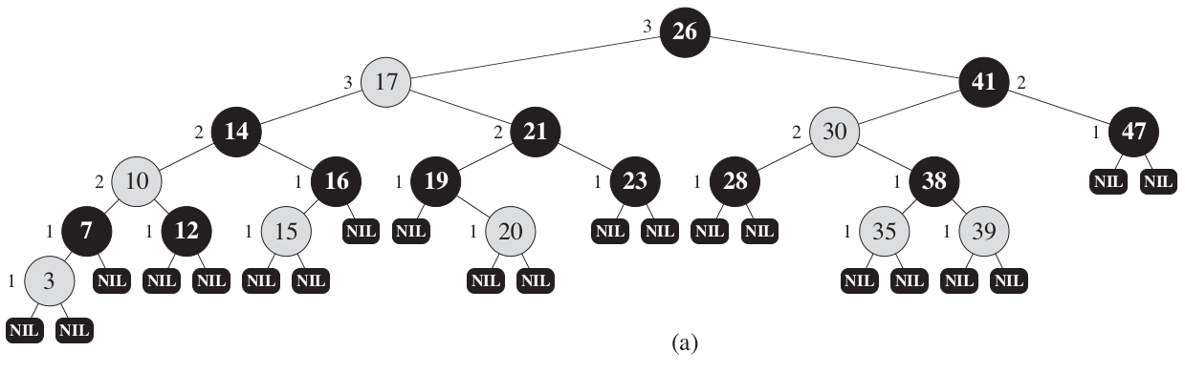
Red Black Tree
A red-black tree is a binary search tree (BST) with one extra bit of storage per node: its color, which can be either RED or BLACK.
By constraining the node colors on any simple path from the root to a leaf, red-black trees ensure that no such path is more than twice as long as any other, so that the tree is approximately balanced.

Slide 50
Red Black Tree
A red-black tree is a binary search tree that satisfies the following red-black properties:
Every node is either red or black.
The root is black.
Every leaf ( NIL ) is black.
If a node is red, then both its children are black.
For each node, all simple paths from the node to descendant leaves contain the same number of black nodes.

Slide 51
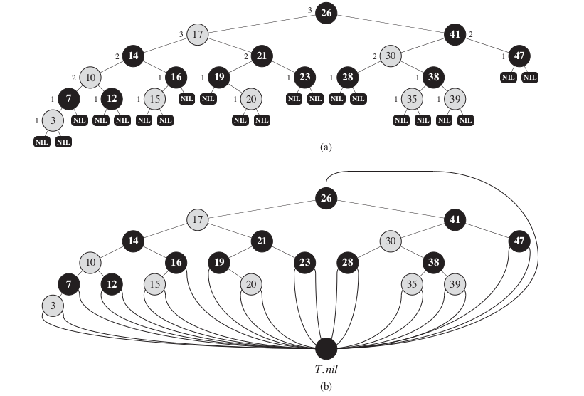
Red Black Tree

Slide 52
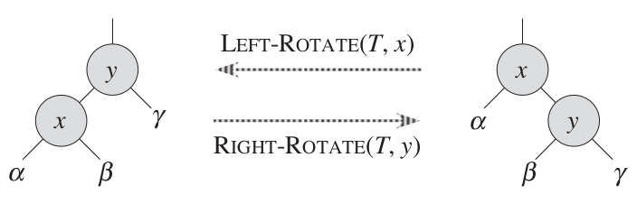
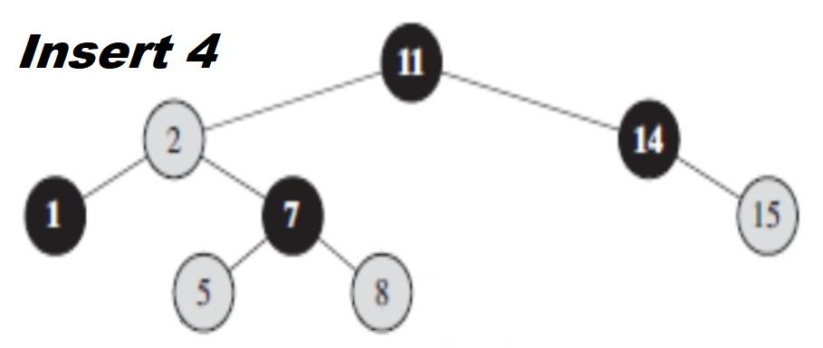
Red Black Tree: Insert operation
Insert in the usual way of inserting a node into a BST.
If the node is root, color it black and return.
Color the new node red.
Fix the colors if the parent is also red.
If it needs a rotate, use RIGHT-ROTATE(T, y) or LEFT-ROTATE(T, x).
Go to step 4.

Slide 53

Red Black Tree

Slide 54

2-3 Trees: A 2-3 tree is a tree that can have nodes of two kinds; 2-nodes and 3-nodes. All its leaves must be on the same level so that a 2-3 tree is always height-balanced.

Slide 55


Slide 56


Slide 57


Slide 58
Construct a 2-3 Tree for the list
9, 5, 8, 3, 13, 16, 11, 14, 7

Slide 59


Slide 60


Analysis of 2-3 Tree:
Lower Bound of number of keys for height h:

Slide 61


Analysis of 2-3 Tree:
Lower Bound of number of keys for height h:
Upper Bound of number of keys for height h:

Slide 62

Analysis of 2-3 Tree:
Lower Bound of n for a given h Upper Bound of n for a given h

Slide 63


Slide 64


Slide 65


Slide 66


Slide 67


Slide 68


Slide 69


Slide 70


Slide 71


Slide 72


Slide 73


Slide 74


Slide 75


Slide 76


Slide 77
Analysis: Inserting a key into a B-tree
For a B-tree of height h, B-TREE-INSERT performs O(h) disk accesses, since only O(1) DISK-READ and DISK-WRITE operations occur between calls to B-TREE-INSERT-NONFULL.
The total CPU time used is O(t h) = O(t log_{t} n).
Since B-TREE-INSERT-NONFULL is tail-recursive, we can alternatively implement it as a while loop, thereby demonstrating that the number of pages that need to be in main memory at any time is O(1).

Slide 78
Transform for good!
</ End of Transform-n-Conquer >

